Slide 1
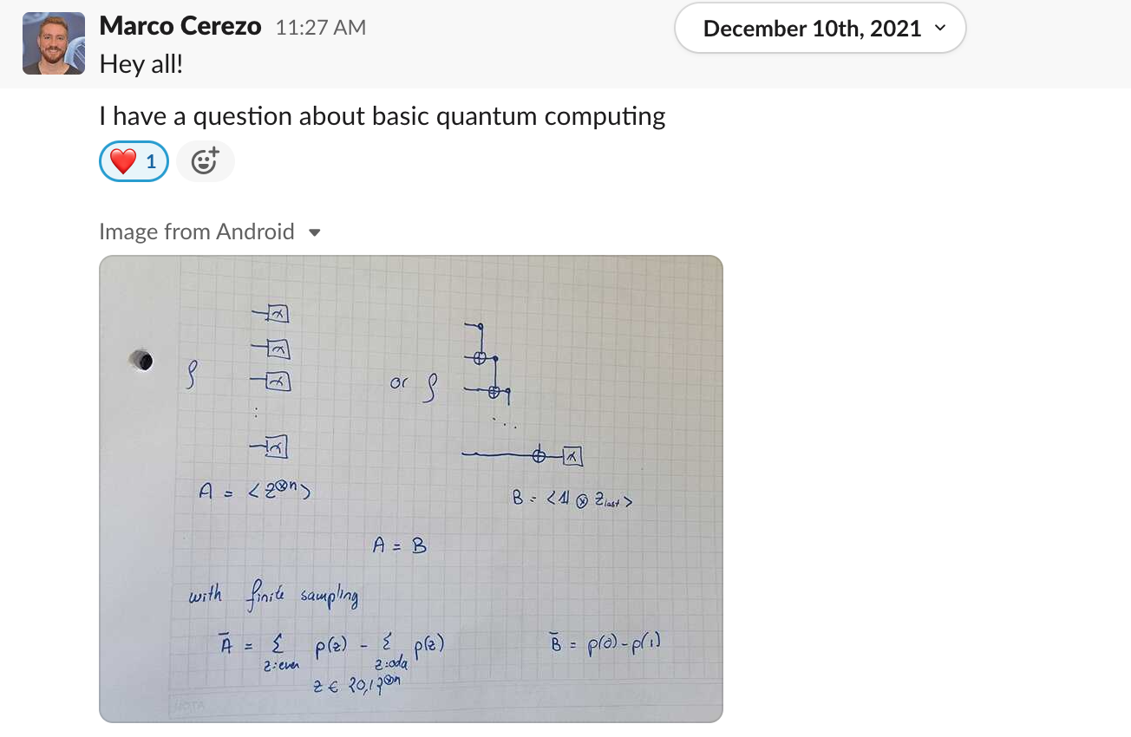
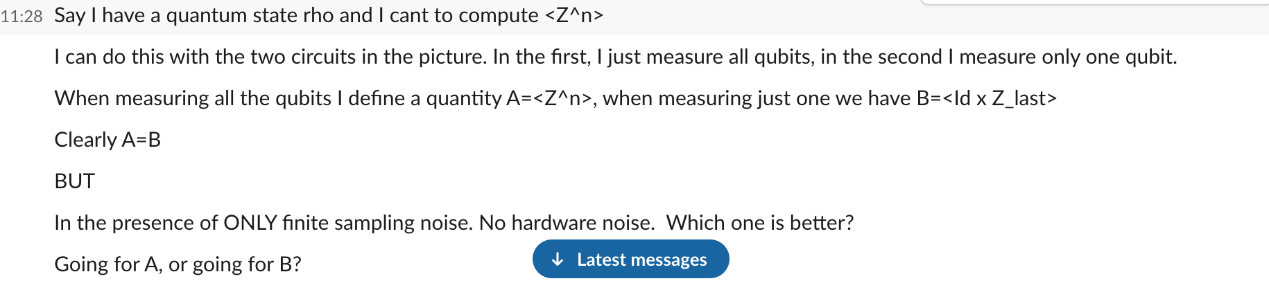
Shot noise question
want

Slide 2
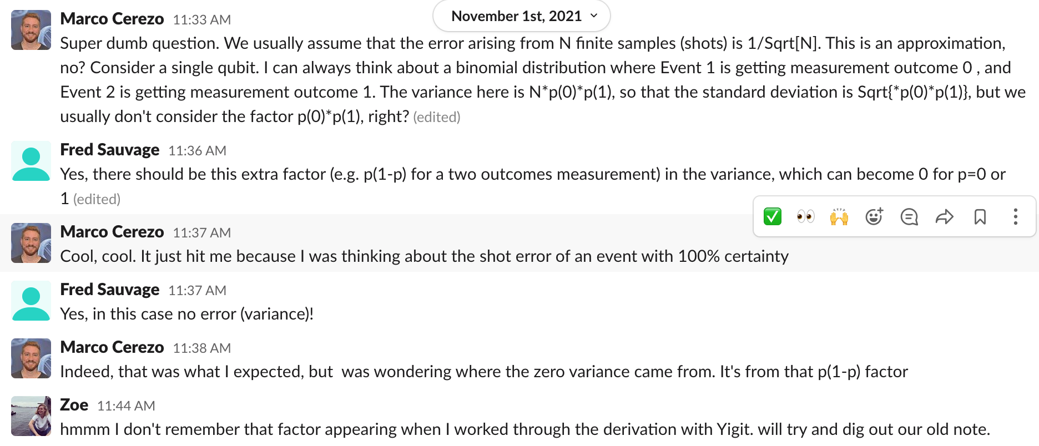
“Yigit’s legendary note”

Slide 3
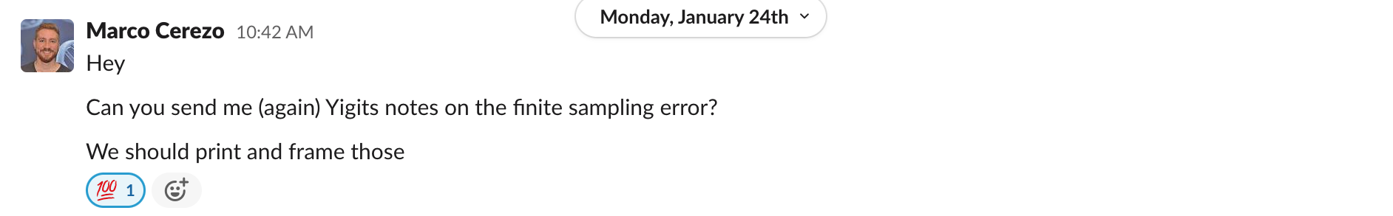
“Yigit’s legendary note”

Slide 4
Shot noise question
want

Slide 6
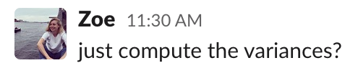
Shot noise question

Slide 7
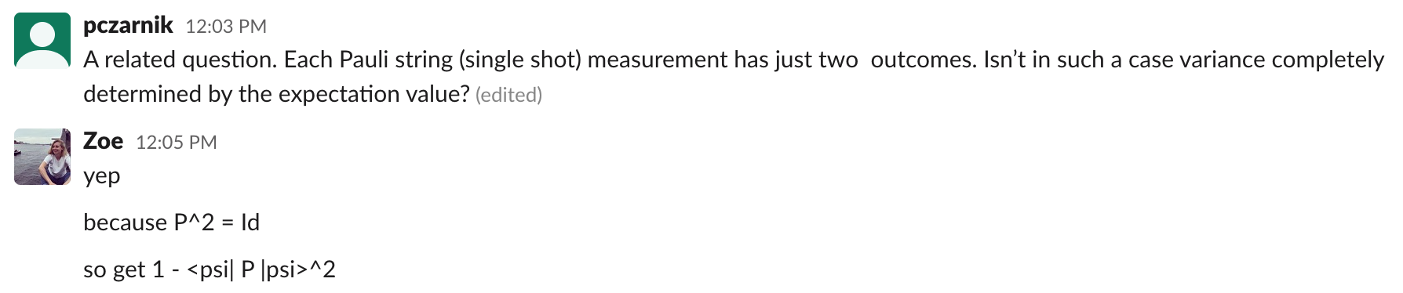
Shot noise question

Slide 8
Shot noise question
Variances are the same.
Therefore shot noise is equivalent.

